Slide 1
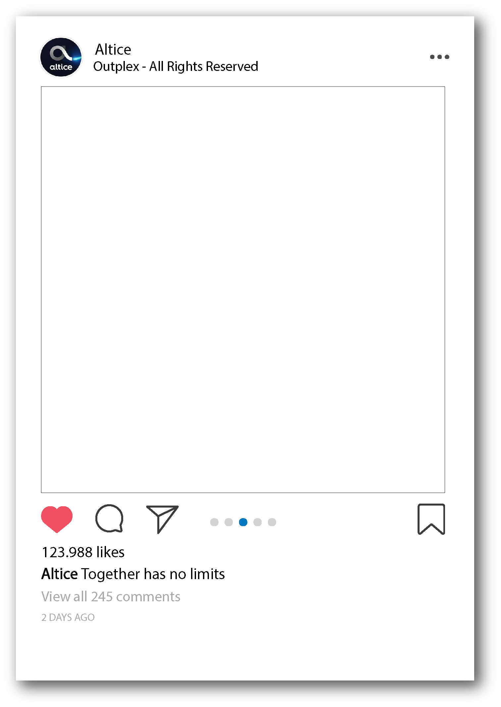
Emails
Melanie Alcantara

Slide 2
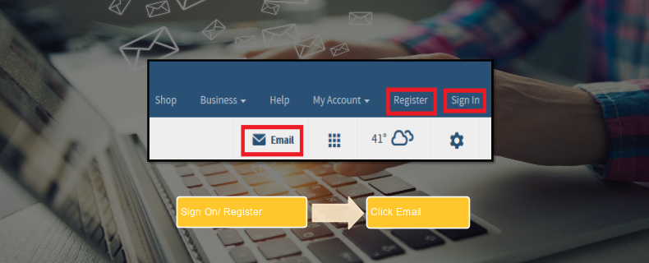
Suddenlink E-mail/webmail
Notes:
“The username is set at the time of registration, and should match the first portion of their email address.The email listed in the customer account is opafin@suddenlink.net. OPAFIN (the first part prior to the @suddenlink.net) would be the username for the customer, and the password can be reset by agents after verifying the PIN number or secret question on a customer account. After logging into the Suddenlink.net website customer will see an email link on the far right of the Suddenlink banner. In addition to the email link customers will also see features to the web site including current weather, settings for the site with help/tools tips, access to the CSR Portal, and a quick find layout that can be found by clicking on the icon that looks like a grid.
Using webmail as a Troubleshooting Tool:
When customer are having issue with their email and they do not already use webmail, agents should immediately log into the customer account and make sure that it is not Suddenlink's service that is malfunctioning. By temporarily logging into the customer account you will be able to test both the outgoing and incoming email servers by sending the customer a test email from their account to their account. This is a common troubleshooting step done by all internet providers who provide access to email for their customers.
After verifying that the Suddenlink service is working agents can then move on checking the customer email client (Outlook, Outlook Express, Windows mail, etc.)

Slide 3
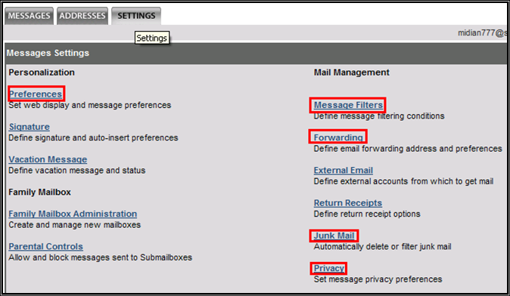
Webmail Settings
Notes:
“The settings tab is the third selection once a customer logs into their webmail. After clicking this selection the customer will be presented with several options to customize their experience with webmail. Much like other webmail based client (yahoo.com and gmail.com), Suddenlink’s webmail is a simple and easy to use solution for customer who do not wish to over complicate their experience by using third party email clients.“

Slide 4
Webmail Preferences
Notes:
“Preferences – There are several options available to customer here but we are going to cover the most customer impacting features. The first feature is changing the name that displays when they send an email. By default it will show whatever the customer registered with as a Name. In this screen shot we have change the name from default to Fat Cat. After making the change click OK and now all sent email will show Fat Cat as the sender.
Message shown per page – The second core feature customers might want to customize is how many email display on their webmail screen. By default this number is set to 10 or 25. This can be raised to as many as 200 but educate the customer that the more emails they set to display will cause a slight amount of lag in loading all of these emails. “

Slide 5
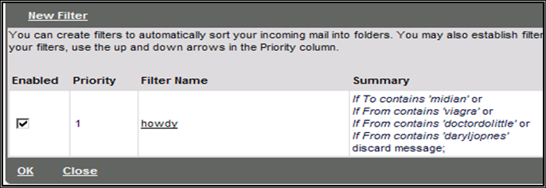
Webmail
Notes:
“How full is my inbox! – The third core feature found is when our webmail sends the customer emails about their inbox being full. This percentage can be altered to whatever the customer prefers. This selection is also located at the very bottom of the preferences selection link.
As you can see the default message setting is at 70%. This means that once the email have exceeded 70% of the total capacity of available Suddenlink’s automated email service will send them an email from noreply@suddenlink.net stating that their email inbox is over 70% full. This is just a simple reminder that customers need to clean out their inbox at some point or email will not be received or lost.
Webmail Message Filters - The message filters section is an additional section where customer can set up rules for email such as spam that makes it through spam filters. A customer can set up 5 selections per rule and set up as many rules as they need. This example filter shows different options on how a customer can customize filters to meet specific needs.”

Slide 6
Webmail Forwarding / Junk Mail
Notes:
“Forwarding – The forwarding option allows a customer to forward email from their suddenlink.net email account to another email address like a yahoo.com account. This option is not typically used by your average customers but sometimes customers prefer the layout of Yahoo or Google mail.
Remember to have the customer check and turn off the mail forwarding option if they state that they were getting emails and are no longer receiving emails. It could be the mail forwarding option is enabled.
Junk Mail Option – The junk mail link provides a way for customer to deal with what the webmail server considers junk email. If the customer wants to keep these emails to double check them they can select the proper option, or they can set it to simply discard these unwanted emails. Below is a screen shot of the junk mail options.”

Slide 7
Email Abuse Tool
Openwave is the tool used to release customers email accounts that have been blocked.
Notes:
Openwave is the tool used to release customers email accounts that have been blocked.
https://208.180.41.111/cgi-bin/abuse/suspend_user.cgi (Direct Link to share with new hires)
NOTE: email suspended ( KDB article)

Slide 8
Email Abuse Tool
Suspend
Reinstate
View Status
View History
Notes:
We have the following options available to us in Openwave to help assist customers with their email access issues:
*Suspend – This option is used to suspend customer email for improper usage such as emailing multiple foreign countries, sending a high volume of emails in too short of a time period or if they send too many messages in one day.
*Reinstate – This option is used to reinstate a customers email address after they have been blocked.
*View Status – This option is used to see what the current status of the customers email is.
* This is so important: If you receive a message that the email address is not found in o=site this means the email does
not exist or has been entered incorrectly.
*View History – This option will give you detail into why the customer is in their current status.

Slide 9
How can you unlock suspended email ?
Notes:
Steps:
Enter email and click on view status.
Then click submit.
Verify if the email is suspended.
Click back.
Then you need to enter the email again and click on reinstate.
Click on view history to see if the email is reinstated and active.

Slide 10
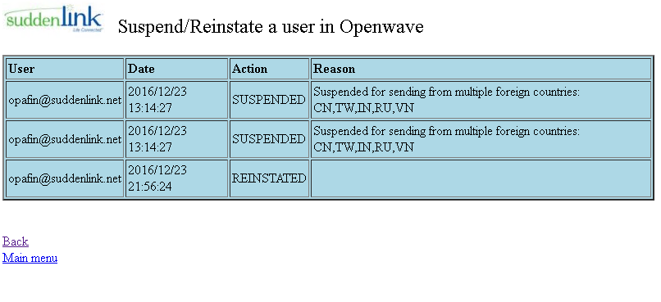
Example history
Notes:
Steps:
Enter email and click on view status.
Then click submit.
Verify if the email is suspended.
Click back.
Then you need to enter the email again and click on reinstate.
Click on view history to see if the email is reinstated and active.

Slide 11
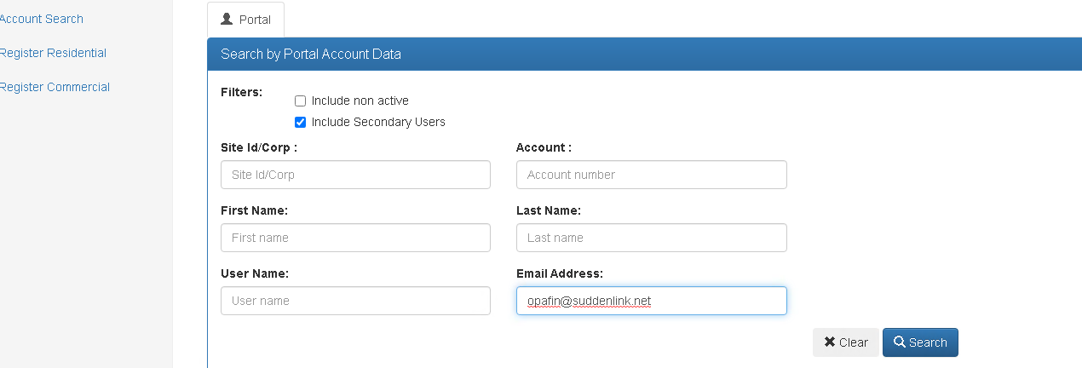
How can you resolve the login issue?
Step 1
Notes:
*Often customers move and they cannot access with their email but it is because their old account is synchronized with their email. Sometimes we can't see that they moved on ida (mt / to) and for that reason they are having that issue.The resolution is go to csr portal, enter the email address and click on search , then you will see the old account. You need to click on the account number and then click on transfer account after that You need to go to IDA and look for the new one , copy and paste it on csr portal then you need to click on search and you will see the new account. Finally , You just have to click on transfer and the account will be transferred.

Slide 12
How can you resolve the login issue?
Step 2

Slide 13
How can you resolve the login issue?
Step 3

Slide 14
How can you resolve the login issue?
Step 4

Slide 15
How can you resolve the login issue?
Step 5

Slide 16
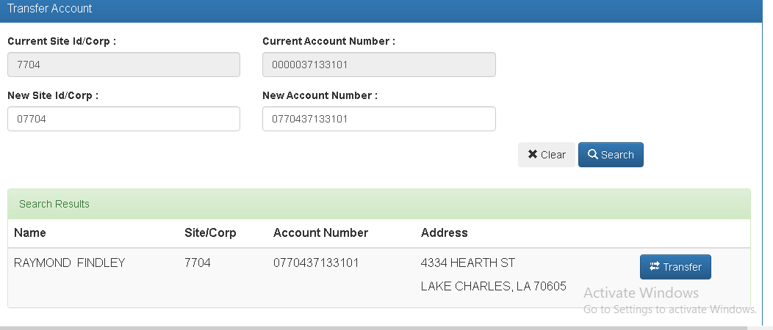
How can you resolve the login issue?
Step 6

Slide 17
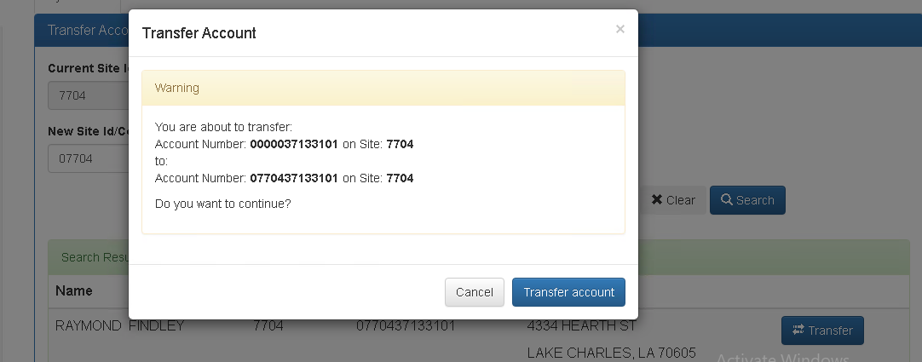
How can you resolve the login issue?
Step 7

Slide 18
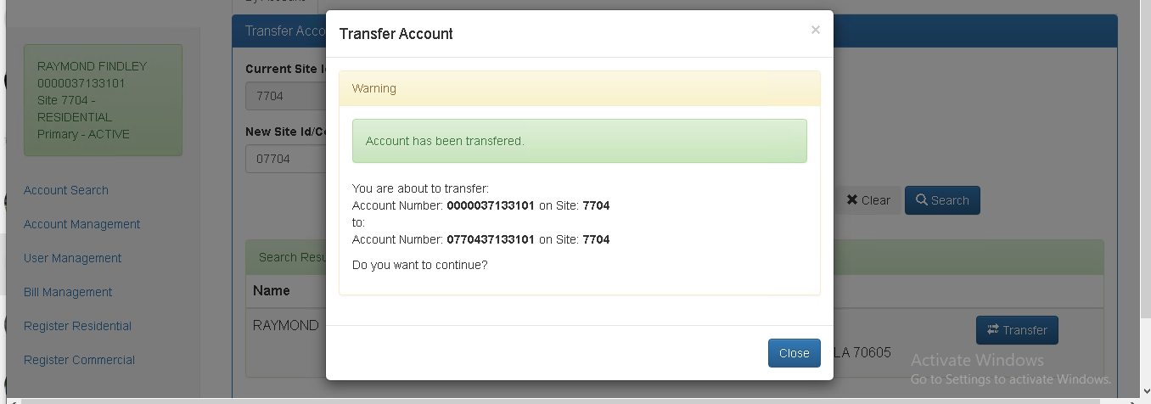
How can you resolve the login issue?
Step 8

Slide 19
Login email issues on the suddenlink website
Notes:
This is how email looks on suddenlink website or their online account. Sometimes we get cases that the customer cannot log into the email ,This happens because the customer cannot access into the online account. The first thing we have to verify that the customer is logging in with the correct username, after verifying the account, we reset the password to their online account and then we reset the password to the email so that both passwords can match and the customer can log in into their account and into their email. to reset the password, we go to csr portal and we do it there.
Note:If the customer is trying to user another website , it is out of scope. For example is they are using outlook , they would go into setting because it would be nothing done on our end. If they are using our website and they are still getting the same issue have the customer log out and back and make sure they click on “get mail” if the issue is they are not getting or receiving mails.

Slide 20
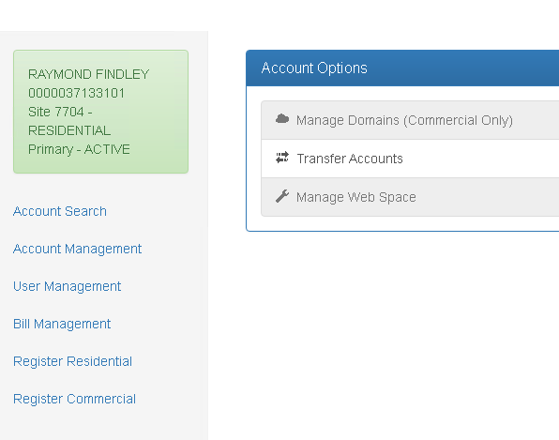
Login email issues on the suddenlink website
Step 1

Slide 21
Login Email Issues on the Suddenlink Website
Step 2

Slide 22
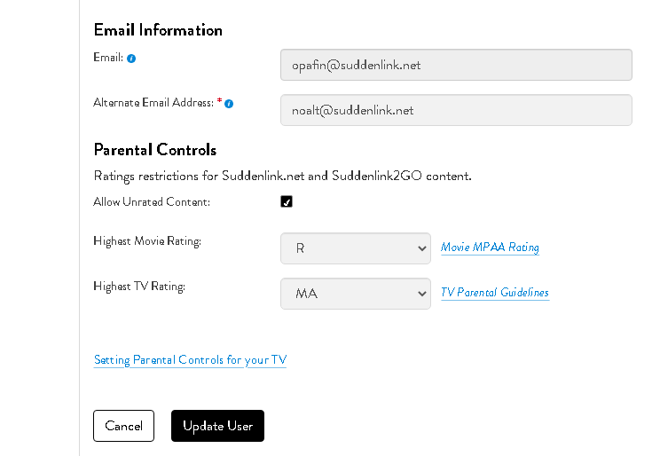
How can the customer change their email ?
Notes:
Only the account holder can change their email on their website.they just have to go to their online account , click on my profile and they will see the email information , They just can change the alternate Email Address and then click on update user after that we go to contact preferences on IDA and update that email so that they can receive the email on that new one.
NOTE: the primary is the suddenlink email for the main username. Once that’s set we don’t change it. The alternate is if they want want to receive important updates to a different email.if it is the authorized user who is contacting us, the account number can create another user with billing management rights by clicking add user.

Slide 23
How can the customer change their email ?
Step 1

Slide 24
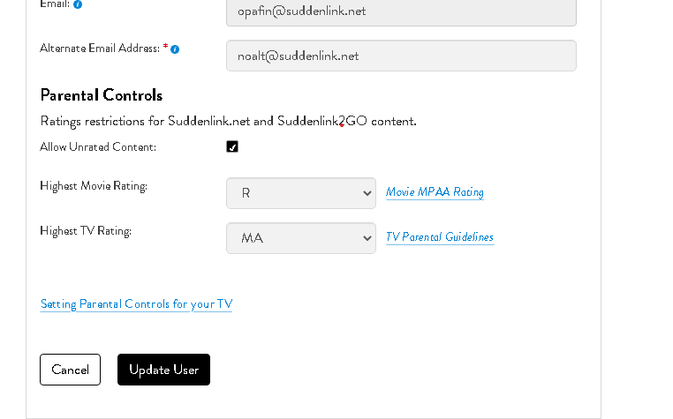
How can the customer change their email ?
Step 2

Slide 25
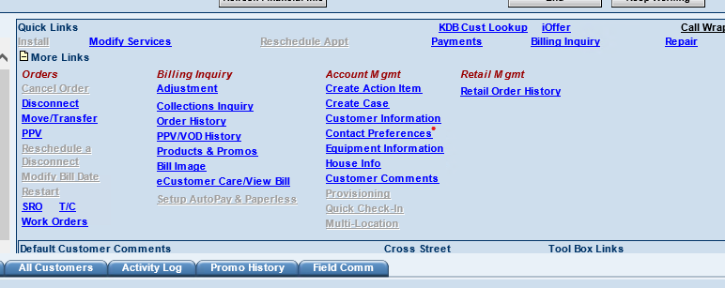
How can the customer change their email ?
Step 3

Slide 26
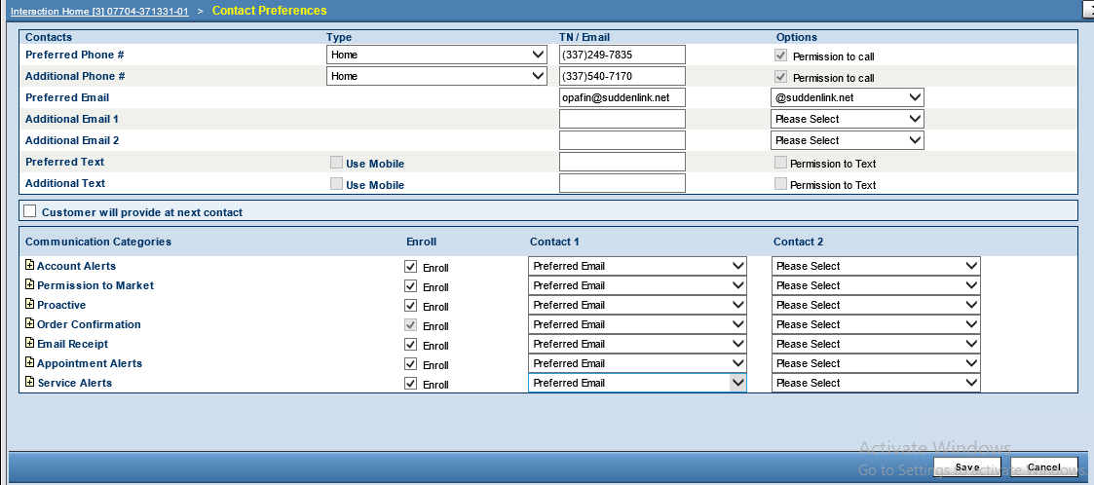
How can the customer change their email ?

